Slide 1

How to create an Excellent Award Entry
2026
Slide Pack
Notes:
Background to arrival

Slide 2

Thank you to our Headline Sponsor
Notes:
Available sponsorships
Excellence in Project delivery
Being Excellent: Practitioner
Being Excellent: Established leader
£2500 each

Slide 3















Excellence In….
Transformation Excellence
Thank you to our award sponsors
Being Excellent
Patron’s Award
Notes:
Available sponsorships
Excellence in Project delivery
Being Excellent: Practitioner
Being Excellent: Established leader
£2500 each

Slide 4
The UK Excellence Awards 2026 Categories
Transformation Excellence
Whether your transformation is cultural, digital or process, this award is for people truly revolutionising their business
Being Excellent
For individuals and teams that stand out from the crowd
Best Team
Emerging Leader
Established Leader
Practitioner
Excellence In….
Business Agility
Change Management
Collaboration
Continuous Improvement Culture
Customer Experience
Employee Health and Wellbeing
Environmental Sustainability
Equality, Diversity, and Inclusion
Innovation
Lean Six Sigma
People Engagement and Development
Project Delivery
Four Award types
Patron’s Award
A free award for organisation and people giving their time to make a difference to society
Excellent People doing Excellent Things
Excellent Organisations doing Excellent Things
Notes:
Categories
Sections and categories in it
Patron’s award – bursary available try to make it cost neutral, relying on all of you to bring in excellent people

Slide 5

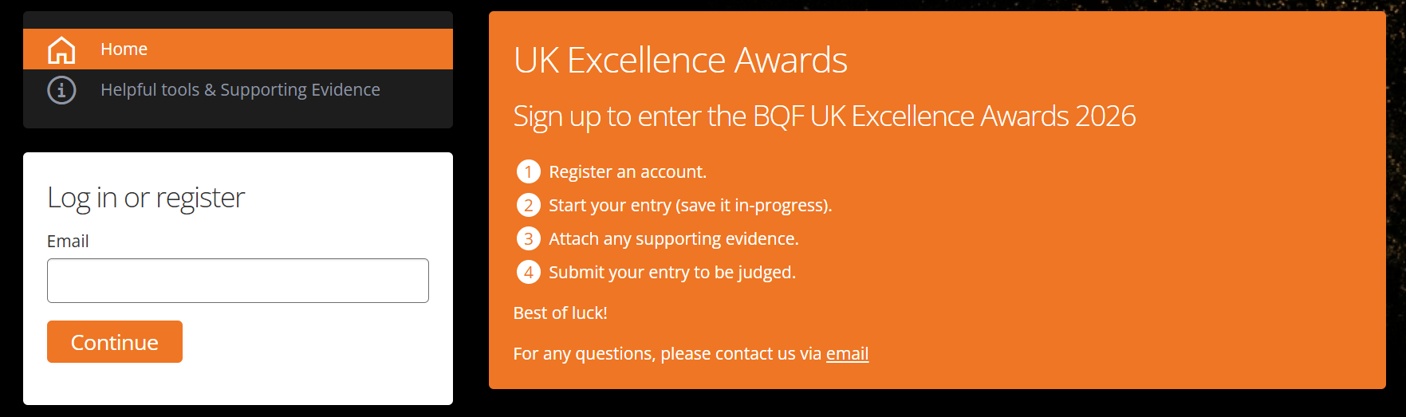
The Awards Timeline
Entries in by end February 2026
Shortlisting completed by April 2026
Judging Panels April – June 2026
Finalists announced #FinalistFriday
Ceremony @Wembley Arena October 2026

Slide 6
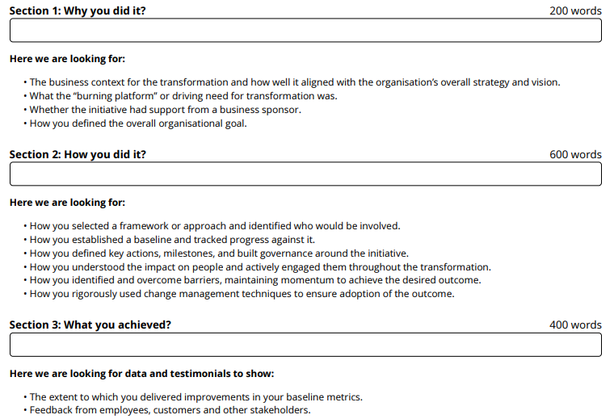
What to expect – written submission
Transformation Excellence & Excellence In
Sample from Transformation Excellence
5 sections:
Why you did it (10%)
How you did it (30%)
What you achieved (20%)
What you learnt (20%)
Cultural impact (20%) (new)
1. Written
Think about quality rather than quantity, videos should be no more than 5 minutes and any presentations or PDFs should be a maximum of 6 pages.

Slide 7
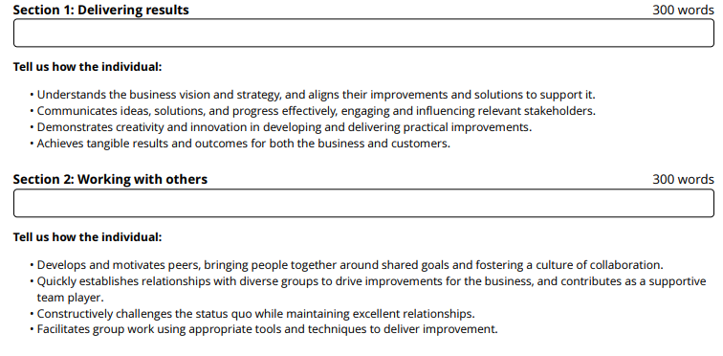
What to expect – written submission
Being Excellent
Sample from Practitioner
4 sections:
Setting direction and delivering results (30%)
Working with others (30%)
Self development & integrity (25%)
What makes this person great to work with - feedback from a range of stakeholders(15%)
1. Written
Slight variation for Best Team
Think about quality rather than quantity, videos should be no more than 5 minutes and any presentations or PDFs should be a maximum of 6 pages.

Slide 8
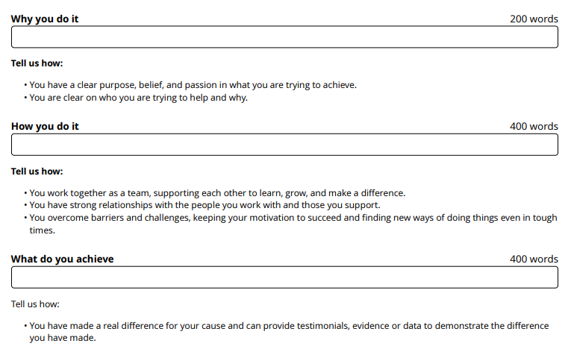
What to expect – written submission
Patron’s Awards
Sample from Patron’s Organisations
3 sections:
Why do you do it (20%)
How do you do it (40%)
What do you achieve (40%)
1. Written
Think about quality rather than quantity, videos should be no more than 5 minutes and any presentations or PDFs should be a maximum of 6 pages.

Slide 9
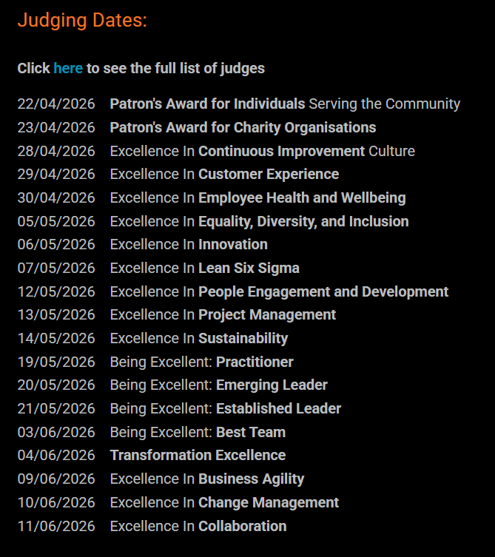
What to expect – Judges’ Round
Teams that are successful in the written submission will be shortlisted and invited to meet the judges.
All judging dates have been agreed and the judges announced.
All panels are made up of 6 judges from a range of backgrounds (previous winners, sponsors, members and industry experts).
Timings are:
  Transformation & Excellence in: 20 minutes + 10 mins Q&A
  Being Excellent & Patron’s: 10 mins + 10 mins Q&A
1. Written
Assume the judges have all read your written entry; use this session to enhance not duplicate
Good time keeping is critical

Slide 10
Public voting round for the Patron’s Awards
1. Written
Finalists of the Patron’s Awards will be invited to create a short video which will be shared publicly
For this they will need to be available for a short interview which the team will edit
There will be a public vote to support generate publicity for the cause

Slide 11
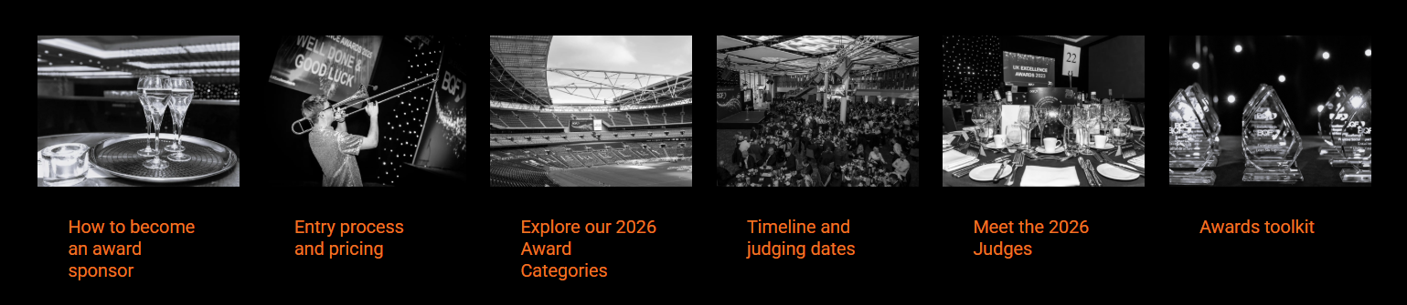
Available resources
Winner Showcases
Award’s Focused Podcasts
Webinars: How to create good entries
Judging criteria published in template form
Past winner entries published
The BQF team – always happy to help

Slide 12
Q&A

